Slide 1
Car Price Analysis
Prepared By:
SNEHA SANTRA

Slide 2
Preventive
Measures
Conclusion
Solution Process
Key Findings
Model Building
Problem Overview
AGENDA

Slide 3
Problem Overview

Slide 4

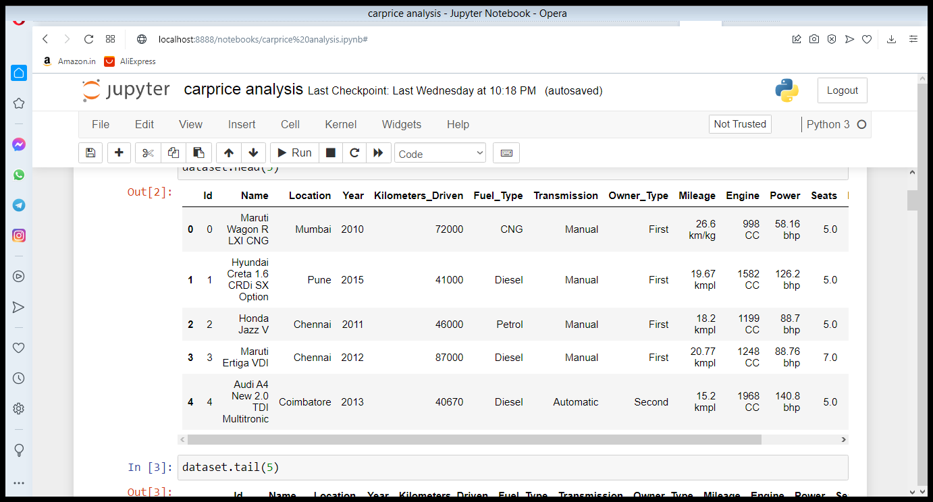



Dataset
Model Validation
Model Performance measure on
testing data
Dataset is scrapped from some website like olx,cardekho and it is build a excel dataset.
Dataset is car price prediction .There are 14 columns and 6018 intities.and we are observed the car price of the car.
STEP
04
Model Preparation
We teach the model
on Training dataset,
STEP
03
Analytical approach
Supervised Machine Learning problem,
Two class Classification,
STEP
02
Analyse Data
Heterogeneous population, Anomaly Treatment, Missing Values Treatment, creating new variable
STEP
01

Slide 5







Key Insights
The most important factors that influence the problem
Brand Name
Car price
Engine
Location
Fuel-Type
Mileage
Kilometers-Driven
Seats

Slide 6
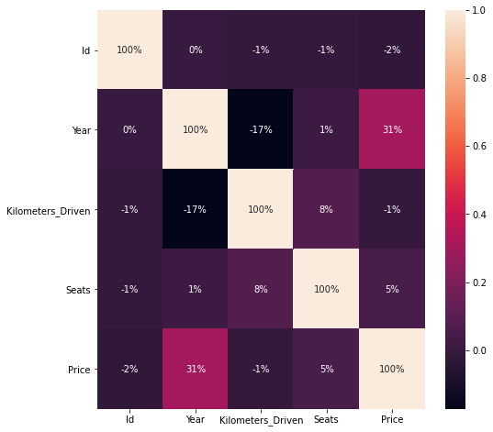
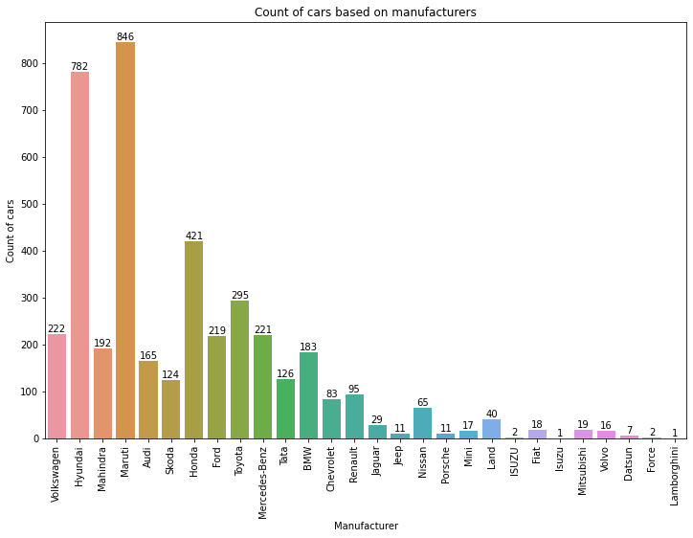
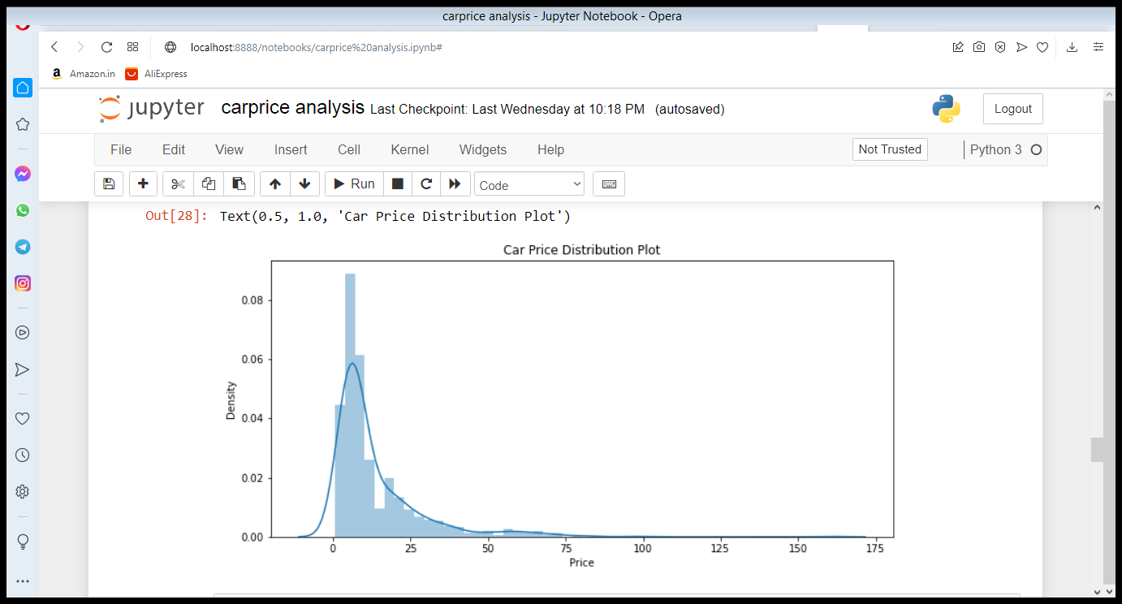
Preventive 5
Preventive 2
Preventive 3
Preventive 4
Preventive 1
Preventing Measures

Slide 7
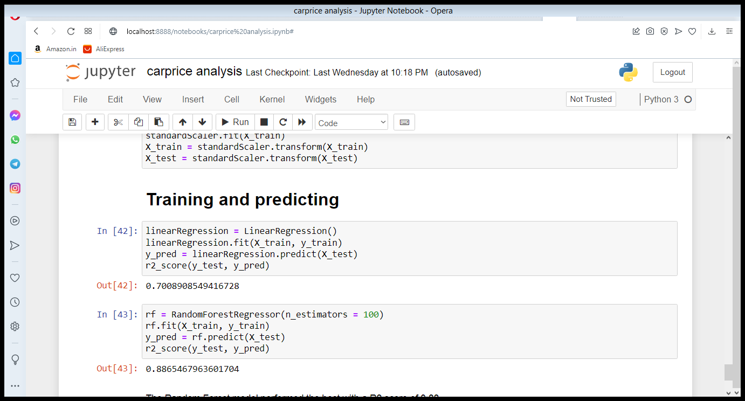
Model Building
Linear Regression
Random Forest Classifier
We choose Random Forest model because the accuracy of the model is 88% and it is best for this dataset

Slide 8
Conclusion

Slide 9
THANK YOU

